Slide 1



Chapter 15
APA
Sample
Manuscript
@ 2012 Wadsworth, Cengage Learning

Slide 2
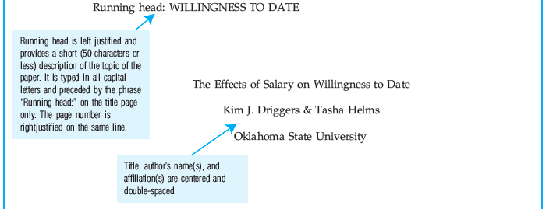
APA Sample Manuscript

Slide 3
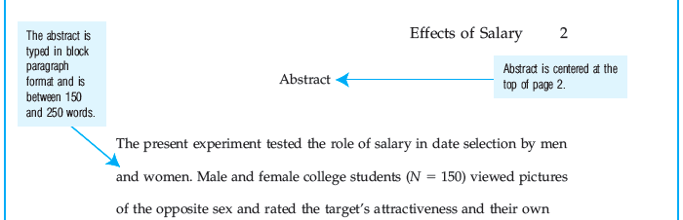
APA Sample Manuscript (cont’d.)

Slide 4
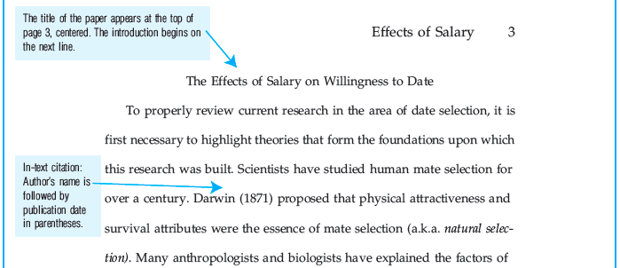
APA Sample Manuscript (cont’d.)

Slide 5
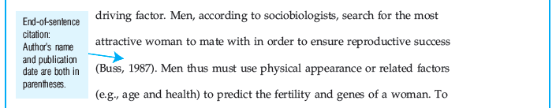
APA Sample Manuscript (cont’d.)

Slide 6
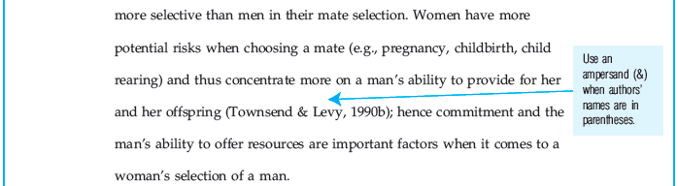
APA Sample Manuscript (cont’d.)

Slide 7
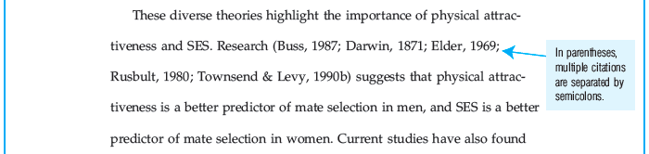
APA Sample Manuscript (cont’d.)

Slide 8
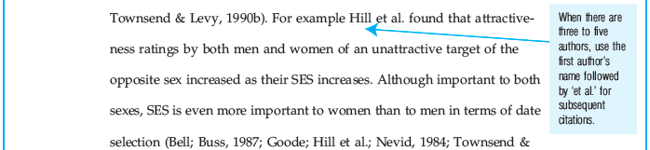
APA Sample Manuscript (cont’d.)

Slide 9
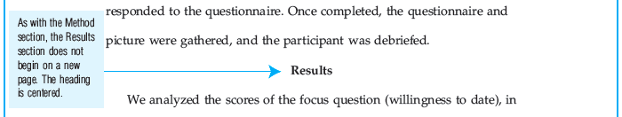
APA Sample Manuscript (cont’d.)

Slide 10
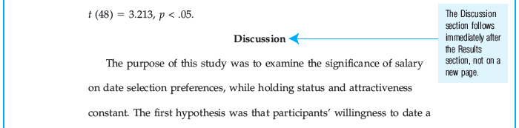
APA Sample Manuscript (cont’d.)

Slide 11
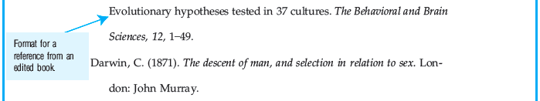
APA Sample Manuscript (cont’d.)

